Slide 1
Clean Core with SAP BTP
SitNL, 16th November 2024
Notes:
Ted

Slide 2
Powered by
Ted Castelijns
SAP Innovation & Technology Lead
Vincent Weiss
SAP BTP Architect
Julian Kuipers
Full Stack SAP Developer
Notes:
Ted

Slide 3
Topics
Introduction
Landscape overview
BTP-management with Terraform
Guidelines and enforcement
Building Blocks
Lessons learned (Already)
Notes:
Ted

Slide 4
Introduction
Team started in 2023 (BTP in-use since 2019)
Greenfield implementation S/4HANA (Private Cloud Edition)
Way of Working is Clean Core
BTP as Extension Platform
Use best practices – Standard processes
No SAPGUI, only Fiori
No ABAP*
Work Zone
Terraform
Data-sphere
SAP BTP
S/4HANA 2023 FPS1
Notes:
Ted

Slide 5
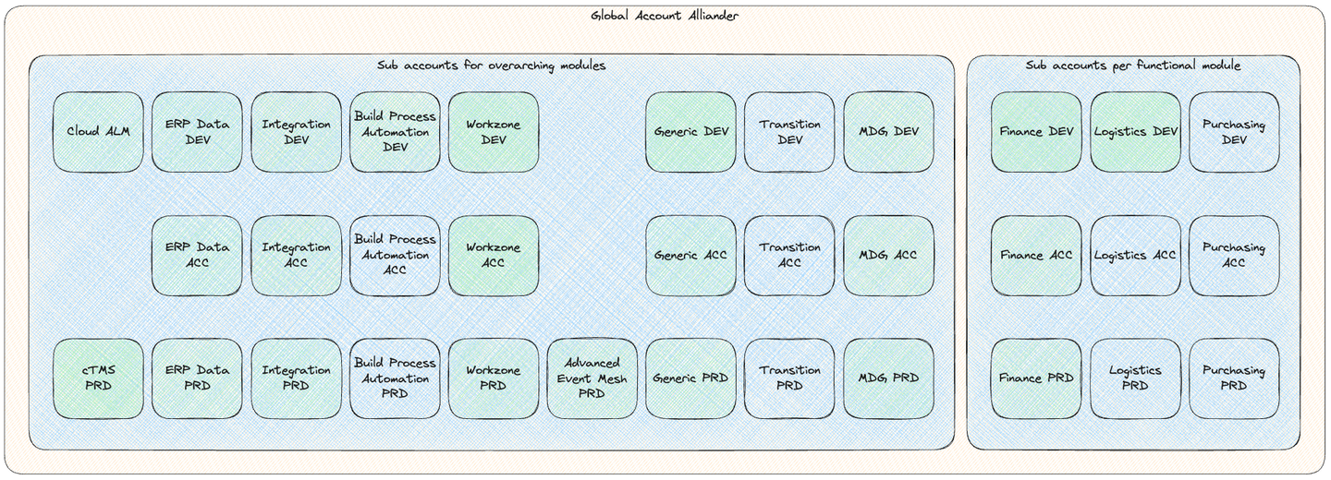
Landscape overview
Notes:
Ted

Slide 6
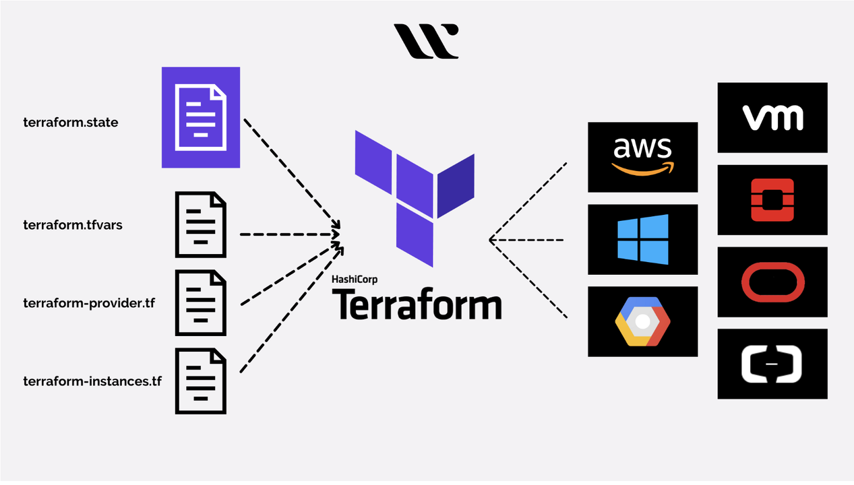
BTP-management with Terraform
Notes:
Ted

Slide 7
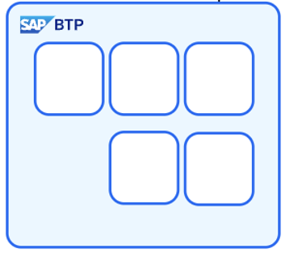
BTP-management with Terraform
Update code
Create PR
terraform plan
Approve PR &
Merge
terraform plan
terraform apply
Notes:
Ted

Slide 8
BTP-management with Terraform
DEMO
Notes:
Ted

Slide 9
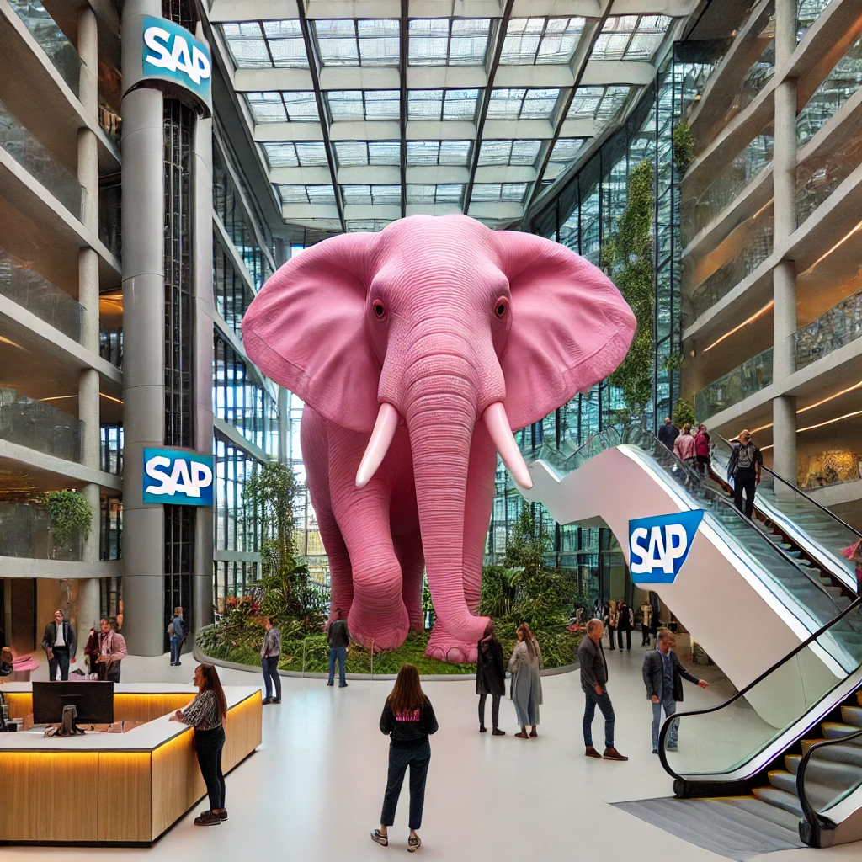
Notes:
Julian
No fun in standard?
New way of developing is challenging(fun) and new technologies/innovation (fun)
Also the solutions are providing more business value since it’s to complex to develop small changes with almost no business value

Slide 10
Why Clean Core+ & Goal
Why
History ECC
Easy to loosen but hard to tighten
‘Clean’ is not always clean
Grey zones
Push to standard
Goal
Simple day2day operations
Yearly upgrades
In control of changes
Notes:
Julian
ECC packed with custom code, no upgrades and hard to develop upon
It’s easier to have something behind your back which you can hand out
Grey zone – custom business object vs RAP BO
Custom Analytical Query is Classic ABAP and it can copy the handwritten queries…
High barrier for custom solution, pushes faster to standard

Slide 11
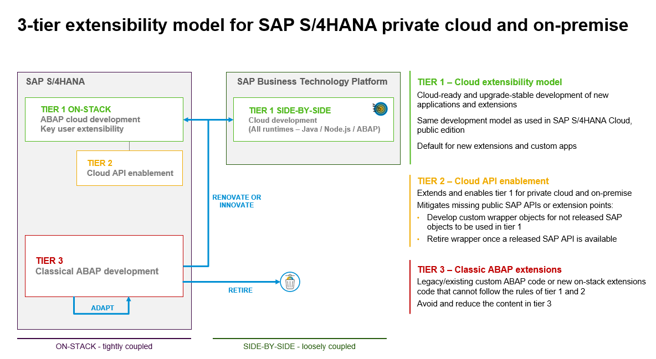
11
Notes:
Julian

Slide 12
Building blocks
Orange
Developer Extensibility
ABAP for Cloud
Red
Classic Extensibility
Standard ABAP
Green
Key User Extensibility
Side-by-Side Extensibility
ABAP for Key Users
Notes:
Julian

Slide 13
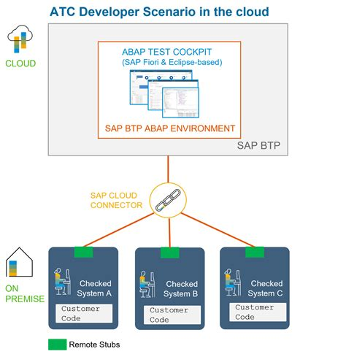
Enforcement
ABAP Test Cockpit
Checks:
Cloud/Clean Core Compliance
Clean ABAP
Runs:
Manual by developer
On release of transport
Scheduled remote runs
Exemptions can be requested
Notes:
Julian

Slide 14
Business
Identifies gap between SAP Standard and Requirements
Defines functional requirements
Developers
Develops Clean Core solutions
Asks for exemptions
BTP Enablement Team
Creates Guidelines
Checks solutions on quality/Clean Core
Helps designing Clean Core solutions
Notes:
Julian

Slide 15
SAP BTP Development
Base Landscape - Tooling
Cloud Foundry Runtime
SAP Build Code
SAP HANA Cloud
SAP Build Process Automation
SAP Build Work Zone
SAP Cloud ALM
Notes:
Vincent
Cloud Foundry Runtime for apps – Kyma not yet worth it. Transitioning when needed relatively easy
SAP Build Code – Business Application Studio as IDE
Database: a Shared SAP HANA Cloud DB
SAP Build Process Automation for Workflows
SAP Build Work Zone as Central Launchpad for all users and apps
SAP Cloud ALM for deploying and monitoring
Most SAP BTP services available for usage

Slide 16
BTP Development
App Development Guidelines
TypeScript​
SAP Cloud Application Programming Model ​
SAPUI5​
GitHub (Actions)​
CI/CD Service
CALM (cTMS)
Notes:
Vincent
TypeScript as the programming language
SAP Cloud Application Programming Model in case extra DB models and/or functional logic is needed
SAPUI5 as Front-End Framework deployed in HTML5 Repo
SAP Work Zone to expose the app.
Deployment to Dev with CI/CD Service, to Acc/Prd with cTMS. CALM to orchistrate
Code stored on Alliander GitHub. Github Actions for PR checking

Slide 17
BTP Development
Coding / Integration guidelines
Unit Testing (80% coverage)
SonarCloud
Monitoring / Logging
Cloud Logging
Security
GitHub Advanced Security
XSUAA – authorization model (SAP Cloud Identity)
Connectivity
SAP API Management
Cloud ALM
SeaLights?
Events preferred
Notes:
Unit Testing Required
Checked with SonarCloud
Looking into SeaLights to also show end-2-end Test Coverage
Monitoring / Logging Required
Open Telemetry
Security
Secure coding checked with GitHub Advanced Security
XSUAA – authorization model required (Entra ID as User Store through SAP Cloud Identity)
Connectiviy – Data exchange
Events preferred
SAP API Management as second option

Slide 18
Golden path
Notes:
Vincent
Following SAP best practices

Slide 19
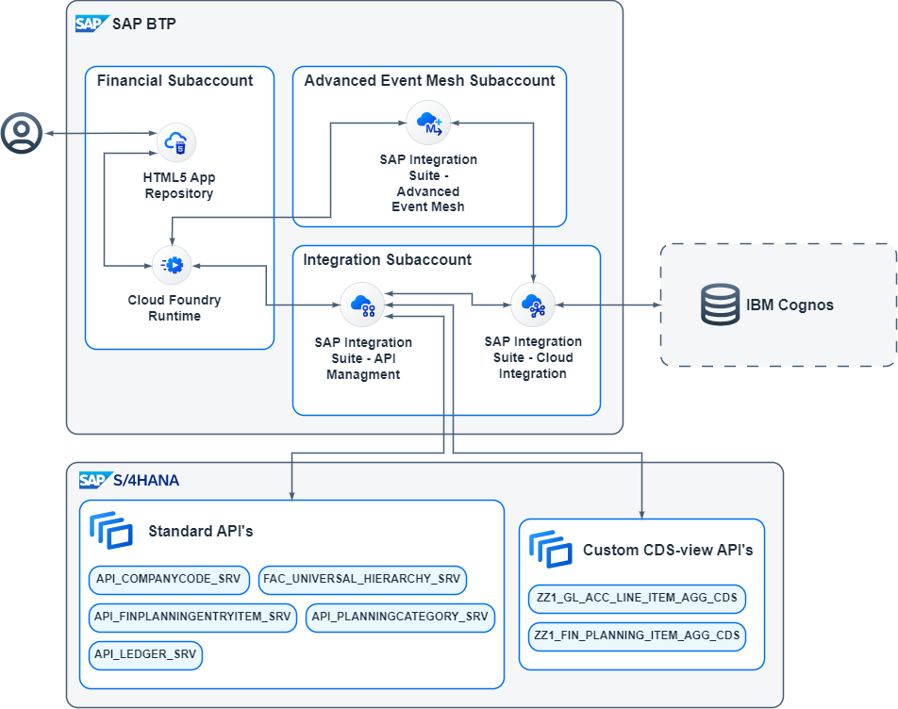
Use-case
Interface with IBM Cognos
Notes:
Julian

Slide 20
BTP-management with Terraform
RESULT
Notes:
Ted

Slide 21
Lessons learned
You need a Thick Skin
Not all SAP software is clean core ready
You need change management
Change in the way of working and thinking
Not all SAP documentation is available/complete
And not all BTP products integrate easily
Generic and re-usable solutions preferred over specific
Smooth yearly upgrades gives confidence about being in control
Speed versus Quality means short term vs long-term
Notes:
Vincent

Slide 22
SAP CodeJam
SAP Integration Suite, advanced event mesh
Wednesday 22nd of January @ The Future Group: 🇳🇱 Event-driven integrations with SAP Integration Suite, advanced event mesh (Zoetermeer, NL)
Thursday 23rd of January @ Emixa: 🇳🇱 Event-driven integrations with SAP Integration Suite, advanced event mesh (Den Bosch, NL)
Notes:
Vincent -> NIET OP DE LINKS KLIKKEN

