Slide 1
Data Citizens ’22 | Sponsorship Prospectus
Stijn “Stan” Christiaens
Founder, Chief Data Citizen
Background
Stan leads Collibra’s Data Office and is responsible for overall data strategy, data infrastructure and translating internal learnings into value for our customers and partners.
He is also Collibra’s product evangelist and drives future innovation. Previously, Stan launched various departments within Collibra including Product, Presales, Postsales, Partnerships, Marketplace, and Research and Education.
Prior to cofounding Collibra, he was a senior researcher at the Vrije Universiteit Brussel, where he focused on application-oriented research in semantics.
Stan holds a Master of Science degree in Information Technology, a Master’s degree in Artificial Intelligence from Katholieke Universiteit Leuven and a Postgraduate in Industrial Corporate Governance from Europese Hogeschool Brussel.
He is a sought-after expert resource, industry speaker and author on the topic of Data Intelligence.
‹#›

Slide 2
Data Governance Unleashed: Integrating Collibra with SAP Datasphere for Trusted Insights

Slide 3
2024 The year
of imagination
Notes:
Everyone talking, think differently in 2024
you need to think faster
need creativity & exploration
need imagination
companies harness that energy, will catapult past the competition
ones that dont, left behind →
Everyone is talking about how you need to think differently in 2024.
You need to think faster.
You need creativity and exploration
You need imagination
The companies that harness the energy of their teams, couple it with the right data, and leverage AI to accelerate, will catapult past the competition
The ones that don’t, well, they’ll get left behind

Slide 4
AI use cases are becoming real
Hi there. How can I help you?
I need to change my reservation
No problem, I can help you with that.
Enterprise chatbots for customer experience
Autonomous factories and supply chains
Automated problem and threat detection systems
‹#›

Slide 5
Enterprises are pursuing AI use cases for productivity and competitive advantage
Over 60%
of business owners say AI will increase productivity
Over 64%
of business owners believe AI will improve customer relationships
Source: Forbes Advisor Surveys
‹#›

Slide 6
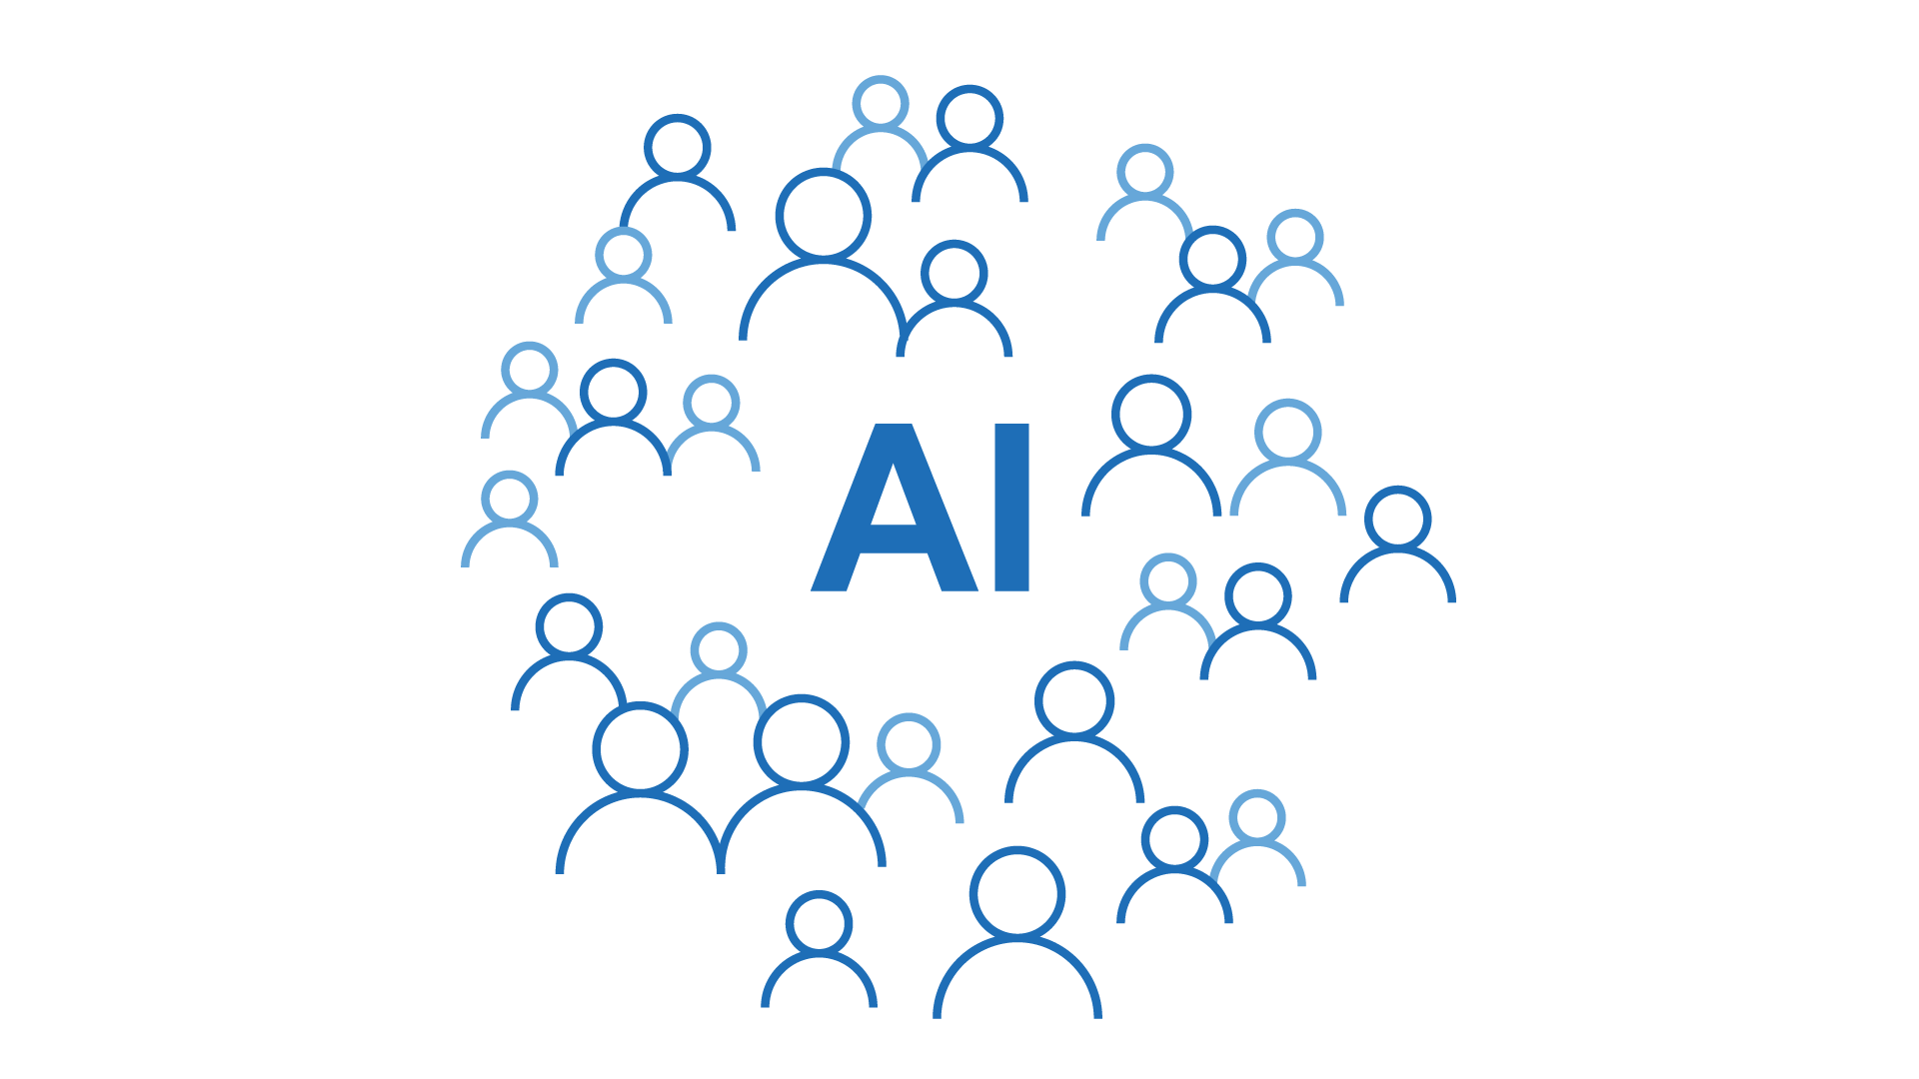
But AI presents new external market
opportunities and new external risks
Risk
Laws/regulations
Customers/clients
Internal
Opportunity
Employee productivity
Customer experience
Scale and velocity
‹#›
Notes:
AI provides both opportunities and risks. As a result there will be winners and losers - the difference between the two will be those who harness the right data, and provide it to the right people at the right time to maximize the opportunity, while still minimizing the risk.
AI presents the opportunity to increase the speed of innovation and drive productivity through automation. But this opportunity must be balanced against the reputational, financial, privacy, and legal risks that can come if we fail to leverage AI responsibly. This is where AI governance comes in. A proper system of AI governance limits risk without decelerating the pace of innovation that is being demanded of companies in this new era of AI.

Slide 7
Connecting business policy to technical implementation is even more important with AI
SHIFT LEFT
SHIFT RIGHT
Engineering teams and their xfn partners
CIO, CFO, CISO, Legal, et al
CDAO
‹#›
‹#›
Notes:
Top down regulated: start with use case
Bottom up “ai happens” learn how to do ai (shift left)
At Collibra, we believe that the Chief Data and Analytics Officer – or the CDAO – has a central role to play in quarter-backing a data-centric approach to AI governance.
In this expanded collaboration, the CDAO works closely with his/her peers across the entire organization, including the CIO, CFO, CLO, the data scientists etc with sponsorship from the CEO to put data at the heart beat of the organization.
With AI use cases, there are more teams that the CDAO will need to align and collaborate with and let me go to the next slide to introduce some roles that you may or may not be familiar with.
Now let's talk through the specific questions and personas involved in AI use cases on the next slide.

Slide 8
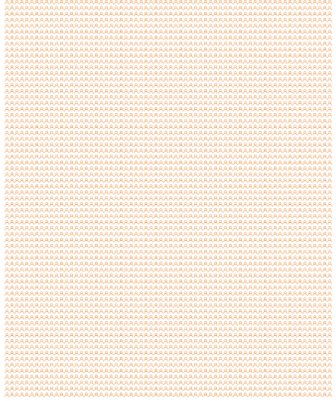
2002
1 CDO
2010
15 CDOs
2014
400 CDOs
2017
4,000 CDOs
2022
152,000 CDOs
Defense (because BCBS239)
+ Offense (because gap)
+ Digital (because business)
+ Data Products (because $)

Slide 9
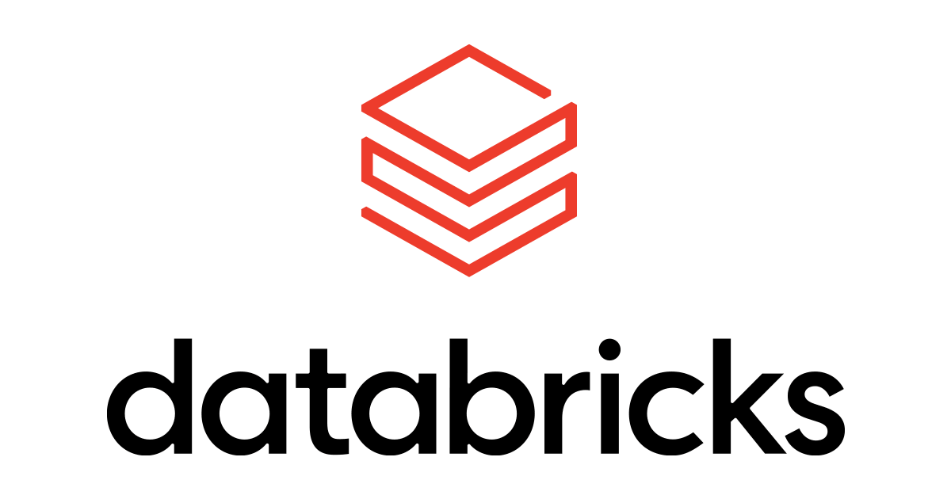
Collibra’s role in an evolving data landscape
Store
Build
Run
Operate
Trust
Comply
Consume
Any storage
Any engine, compute or tool
With unified governance for data and AI
Raw Data
Business Value
Open table formats Iceberg, Delta, Hudi
Technical data catalog Physical metadata
Enterprise metadata graph Physical, logical, conceptual, semantic, systems, policy, …
Data quality and observability
Policy setting
AI-automated & collaborative stewardship
Technical stakeholders
Business stakeholders
Policy enforcement Business context and semantics
Data products
and marketplace
Notes:
Felix
Any data: Open table formats have enabled the lakehouse architecture so that data engines are able to process data wherever it is stored.
Any engine: Unified & adaptive governance provides the same level of abstraction so that organizations have flexibility to adopt any data engine.
Unified & adaptive governance is based on:
Business-driven & adaptive policy setting by business stakeholders to ensure alignment with business priorities, scope, use-cases and outcomes.
Bottom-up observability by continuously monitoring, tracking, and alerting the different data platforms
Unified governance by connecting technical and business stakeholders, and technical and business metadata assets
AI-assisted automation leveraging a unified metadata graph to significantly automate the stewardship curation and policy management work.
Policy enforcement by executing policies (quality, security, access, …) natively in the underlying data platforms for performance, scale and simplicity.
Easy data consumptions of highly curated data (products) by business stakeholders

Slide 10
Technical
Users
Business
Users
Data
Scientist
Data
Engineer
Data Architect
Business Analyst
Privacy Manager
Data
Steward
Collibra Data Intelligence Platform
The #1 enterprise platform for trusted data
Data Quality
Data Catalog
Data Governance
AI Governance
Improve the quality
of your data
Organize your data
Govern your data
Govern your AI projects
Active Metadata + Collibra
Data Stores and Applications
Hyperscalers
Lakehouse and BI Tools
Integrations
100+
pre-built integrations

Slide 11
There’s a better way to govern your data estate
Collibra delivers the best-of-breed data intelligence platform that tightly integrates data catalog, governance, lineage, quality, and privacy capabilities
SAP Datasphere is the foundation for a business data fabric architecture that enables seamless access to business data with semantics and business context intact
Notes:
Together with Collibra, we will deliver end-to-end data governance across the business data fabric to our customers.

Slide 12
SAP Datasphere is the foundation for a business data fabric architecture
Data consumers
Planning and analytics
Intelligent data apps
Data science
SAP Datasphere running on SAP BTP
Security
Access control
Availability
Self-service data access | Virtual data products
Data discovery | Business content, data marketplace, recommendations
Orchestration | Data transformation and data ops
Processing and persistency | Warehousing, business semantics (analytic and relational models), knowledge graph
Data governance | Metadata management, catalog, lineage, privacy, data quality
Data ingestion | Data replication, data federation, real-time data, application integration
SAP and third-party data
Applications
On-premise data warehouses
Cloud data warehouses and lakehouses
Relational
databases
Unstructured and semistructured data
Notes:
In a major moment for our industry and customers, SAP is partnering with an open data ecosystem of leading technology vendors to provide tailored integration between SAP Datasphere and their solutions, alleviating organizations’ need to simplify, integrate, secure, and govern the data landscape.
Collibra will integrate with the data governance layer of SAP Datasphere to future proof data governance, privacy, and compliance initiatives and bring the unique strengths of their own ecosystems to the business data fabric.

Slide 13
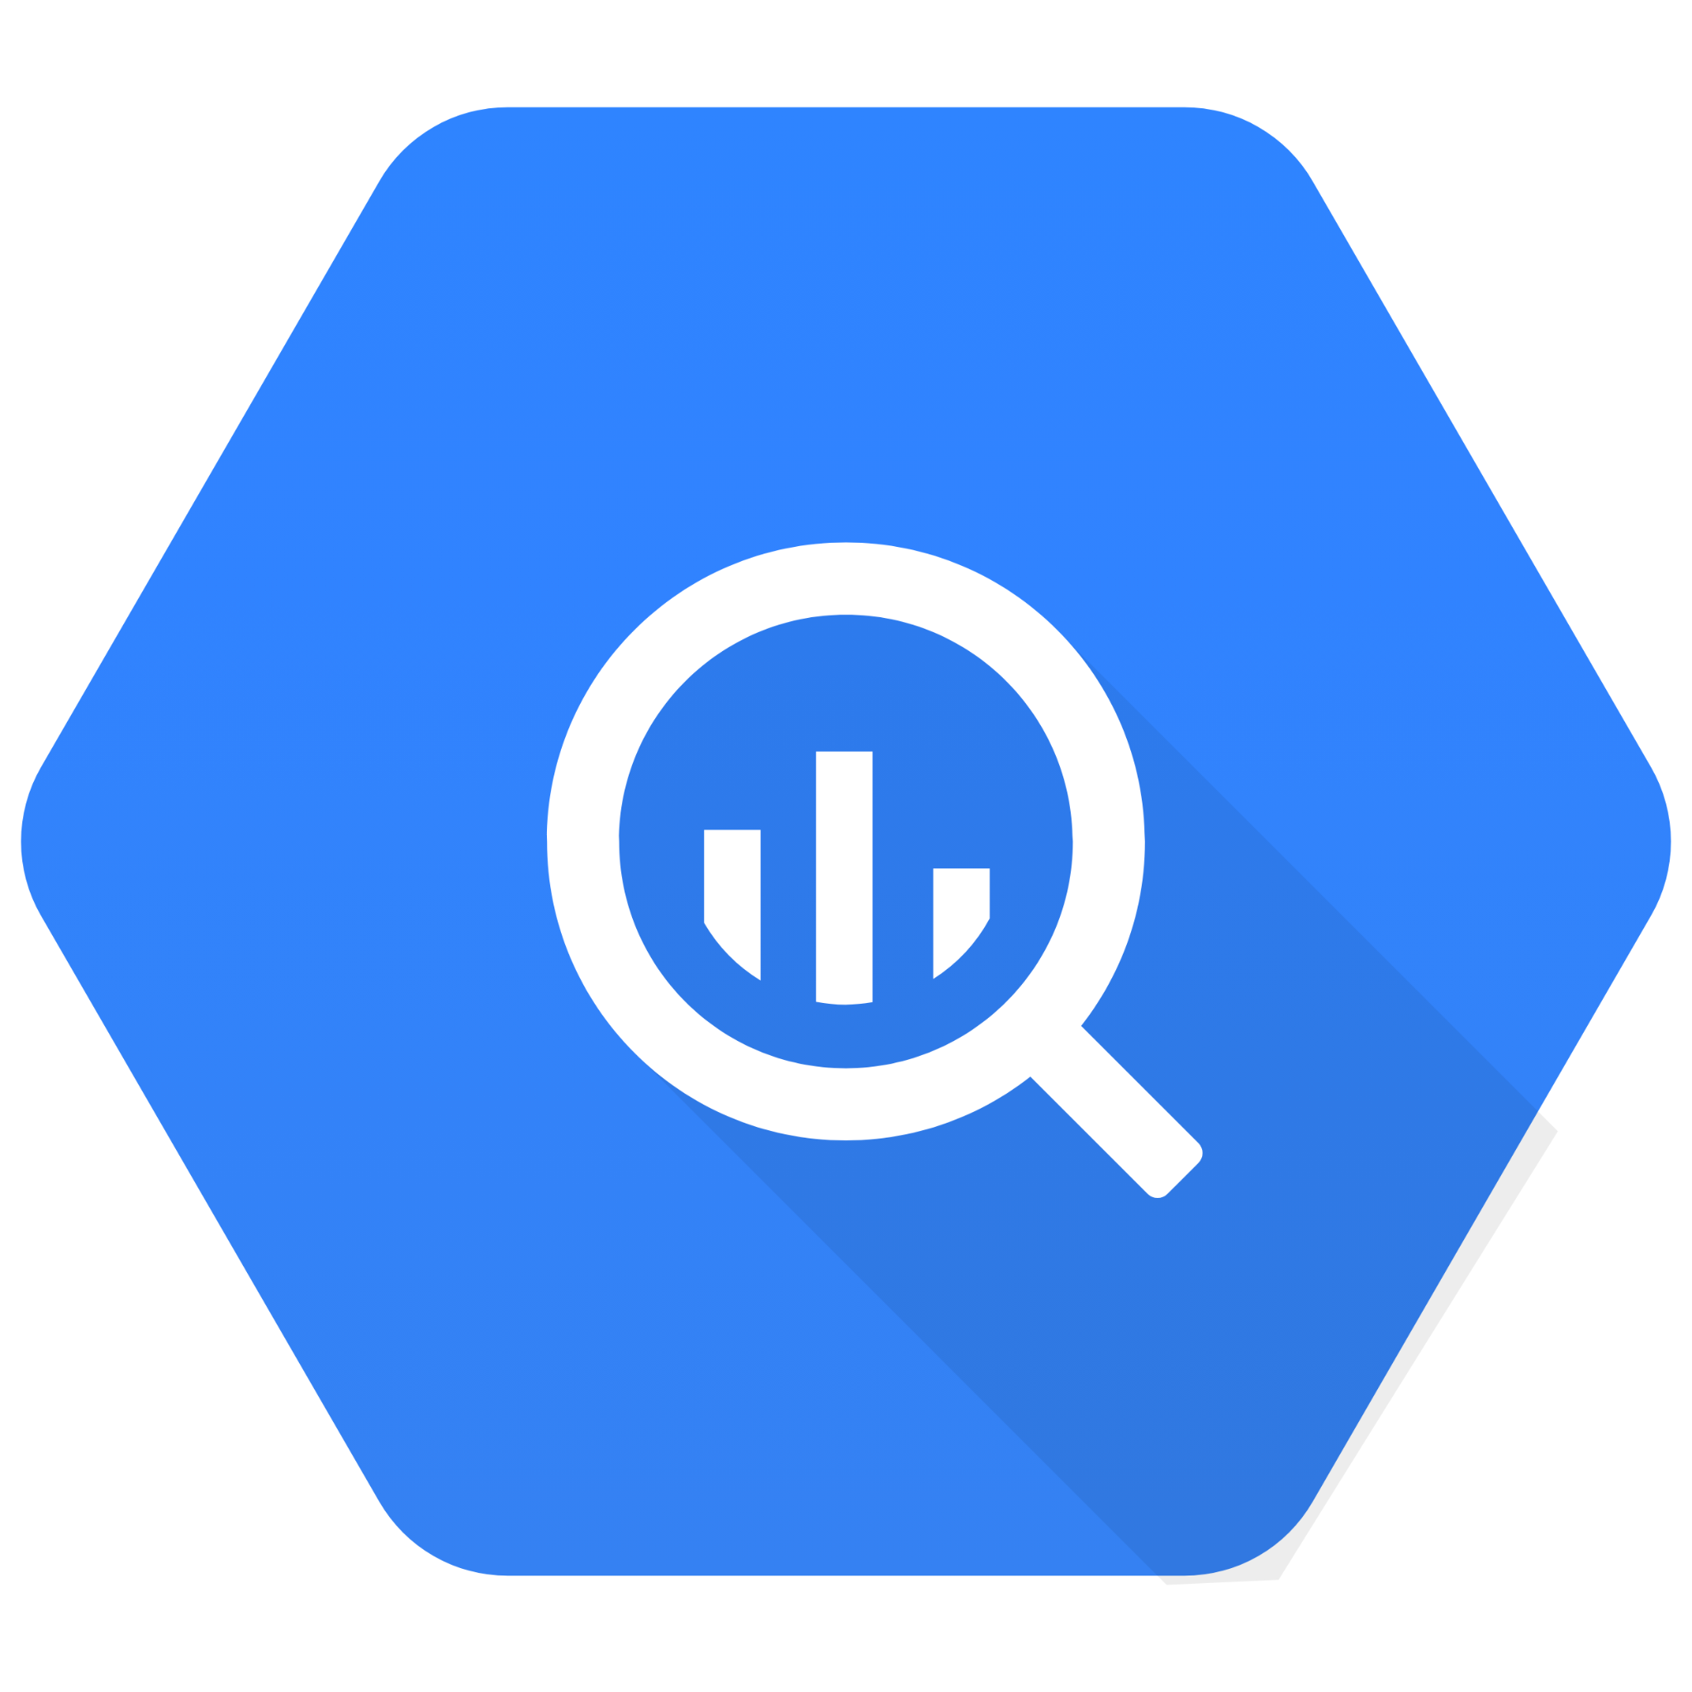
Technical
Users
Business
Users
Data
Scientist
Data
Engineer
Data Architect
Business Analyst
Privacy Manager
Data
Steward
Governing your business data fabric
Data & AI Governance | Data Privacy, Lineage & Policy | Data Quality & Observability
Metadata stored in SAP Datasphere
SAP Analytics Cloud
SAP Datasphere models
Databricks
Databases
Tableau
SAP BW4/HANA
SAP HANA Cloud
SAP S/4HANA
Google BigQuery
Data lakes
Power BI
Data warehouses
Applications
SAP
Other Sources

Slide 14
Current state: Collibra integration with SAP
Collibra Direct Integrations to SAP | Collibra / SAP Datasphere Integration
Collibra DIP SAP HANA (XSC, XSA, HANA Cloud) - metadata, calculation view and SQL statement based lineage SAP ERP (ECC / S/4 Hana / MDG) - metadata only SAP BW - metadata and table level lineage only SAP Success Factors - metadata only SAP Sybase ASE - metadata SAP LeanIX - metadata (LeanIX created) Collibra DQ SAP HANA/HANA Cloud - Collibra DQ pushdown (GA in 2024.10) | Datasphere Catalog integration - GA SAP Analytics Cloud objects and details Stories Models Measures/Dimensions Metadata and object-level lineage for SAP Datasphere Local/Remote Tables Views & Intelligent Lookup Analytic Models Perspectives Collibra DQ - (GA in 2024.10) Pushdown for SAP Datasphere
*The development, release, and timing of any features or functionality described for Collibra’s products remains at the sole discretion of Collibra
‹#›

Slide 15
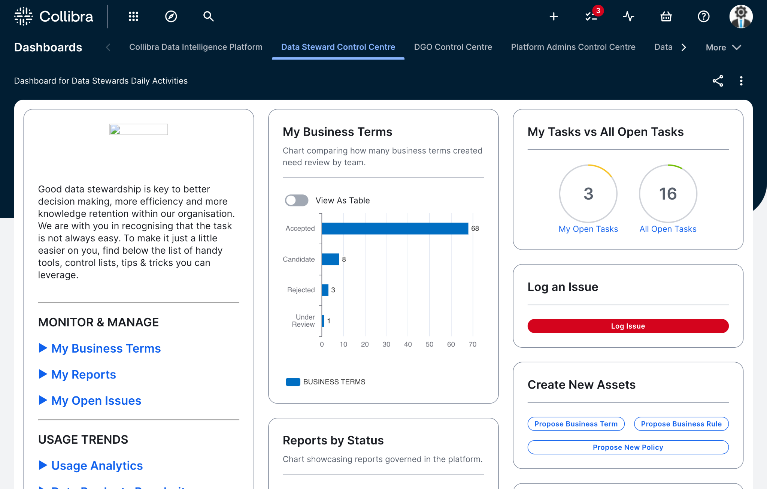
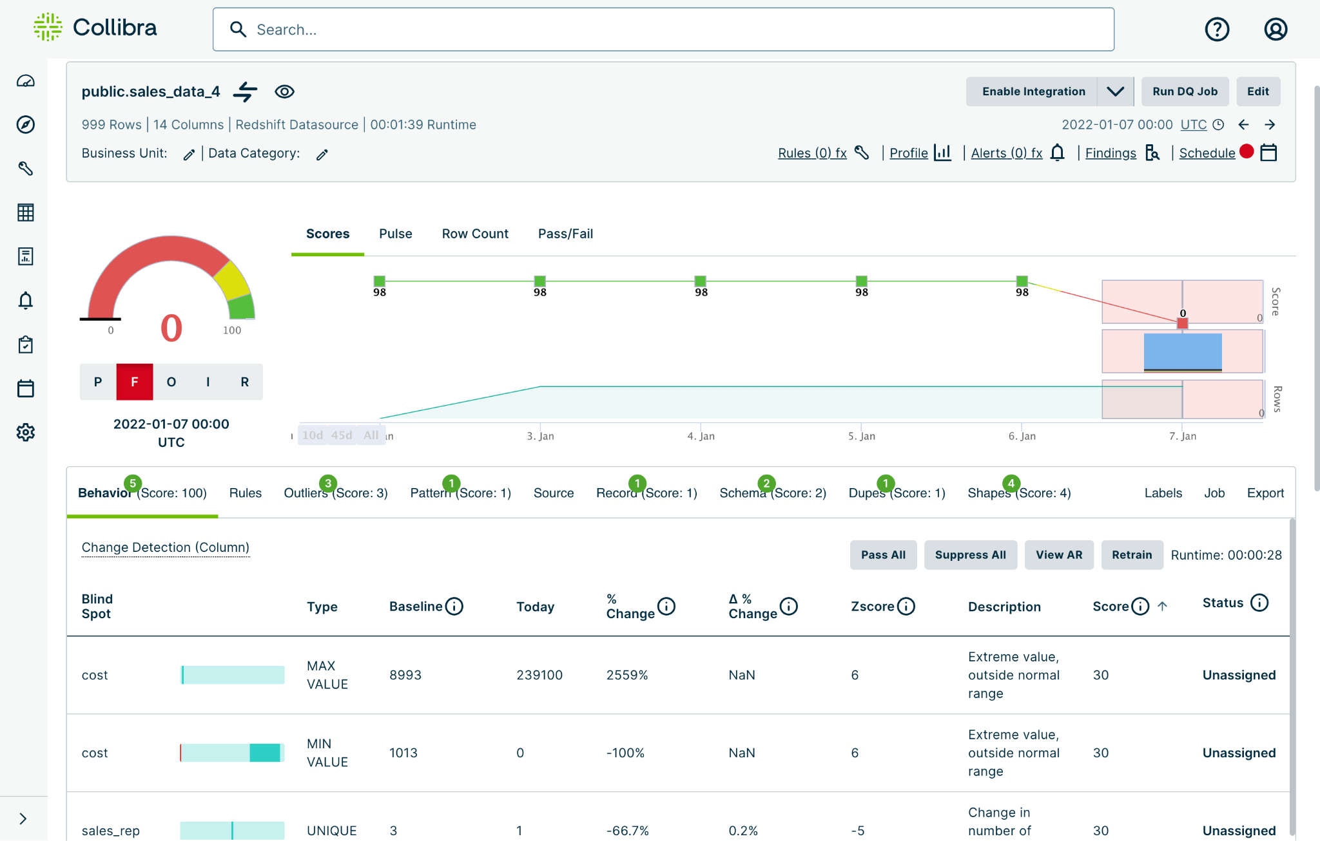
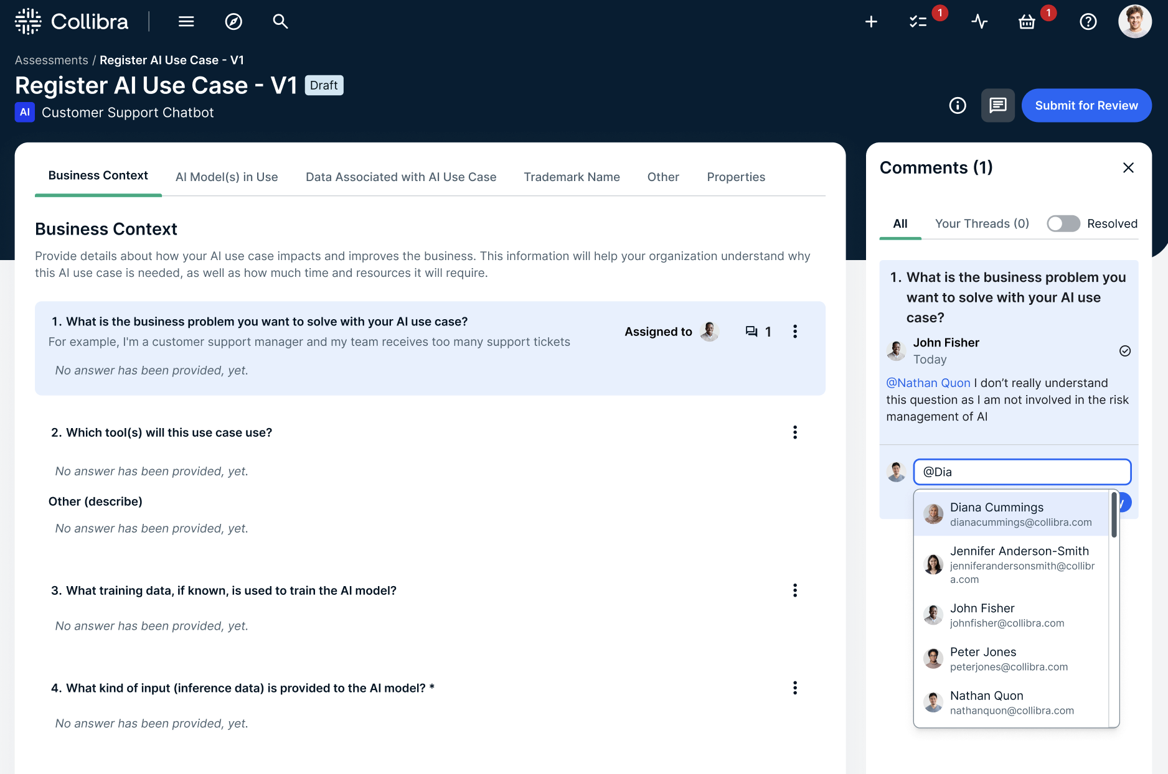
Collibra & SAP - Better Together
Streamline governance of your business data fabric
Establish a high-quality data foundation
Deliver trusted AI
Complete data governance across the business data fabric for SAP and other data, AI and analytics sources
Increased trust in data-driven initiatives with a scalable approach to data quality across all sources
Unified governance of AI models and data assets across SAP and other AI platforms.
Notes:
Engie,
Lockheed - tableau Porsche – Datasphere customer / Adobe – Trusted Reporting – different C-levels reporting different metrics to CEO. McDonalds – Data Products. Accenture – 75000 people – marketplace powerd by Collibra / 10.000 reports that they make available to their users.

Slide 16
What’s in it for customers? Recent SAP/Collibra customer wins
Global Candy Company
EMEA Beverage Company
Global Technology Company
Streamline governance of your business data fabric
Establish a high-quality data foundation
Deliver trusted AI
Business goal
Support digital transformation and ensure a successful SAP S/4 HANA adoption
Business issue
Lack of ability to easily find and use data relevant to specific roles impact efficiency of the business (supply chain, logistics)
Solution
Сomprehensive data catalog, data lineage, and a business-friendly data marketplace integrated with SAP Datasphere, to streamline data access and collaboration around data
Business goal
Support intelligent business decisions to accelerating migration from SAP ECC to SAP S/4 HANA
Business issue
Lack of confidence in data quality of the migrated data and manual DQ process can derail the whole migration process and its results
Solution
Data quality and observability platform with AI/ML rules, user-friendly experience and data governance capabilities
Business goal
Breakdown silos and create transparency across all data and AI assets for the entire SAP and non-SAP data and AI landscape
Business issue
No centralized place to track and manage AI projects cross the corporate AI team, AI Labs, and data scientists dispersed across business units
Solution
Unified and comprehensive approach to data and AI governance across all data sources and AI platforms.

Slide 17
Collibra value with Datasphere
Migrate high quality assets
Data Quality Management
Have visibility and governance wrapped around your migration to Datasphere, BW4/HANA, S4/HANA…
Comprehensive coverage through SAP HANA of critical data to ensure high quality, and catch issues
Regulation & AI Governance
Full ecosystem discovery
A rich layer of governance assets above data, data products and AI that provides context, ownership and visibility.
Visibility, metadata and lineage across all SAP and non-SAP sources for a complete picture of your data ecosystem

Slide 18
Use case focus
1. Streamline Trusted Business Reporting
2. Accelerate Trusted Data Access (Optimize Data Lake Productivity)
3. Enable Enterprise-Scale Data Quality
4. De-risk and Expedite Cloud Data Migration
Centralize, govern and certify key reports and metrics, driving increased trust in reports
Expedite access to trusted enterprise data via cataloging and search capabilities
Increase automation of data quality rules to optimize enterprise data quality
Enhance the value of cloud data by adding context, classifying, deduplicating and cataloging
5. Eliminate Duplicate Data Spending
6. Accelerate Regulatory Reporting
7. Automate Data Privacy Governance: GDPR
8. Automate Data Privacy Governance: CCPA
Centralize and catalog purchased data assets to rationalize and reduce spend
Achieve, scale and sustain regulatory compliance beyond short-term deadlines
Operationalize GDPR by centralizing, automating and guiding privacy workflows
Operationalize CCPA by centralizing, automating and guiding privacy workflows
9. Optimize Data-Related Impact Analysis
10. Automate Trusted Data Governance
11. Catalog & Govern APIs and Integrations
12. Catalog & Govern Technology Assets
Improve and expedite the ability to anticipate potential disruption caused by data-related changes
Centralize the definitions of key terms and metrics and apply stewardship and accountability
Centralize, catalog and govern enterprise APIs to enable reuse, driving developer productivity
Centralize, catalog and govern technology assets to improve tracking and asset reuse

Slide 19
Northern Europe - Collibra + SAP
What we see in the region
Streamline Trusted Business Reporting
Accelerate Trusted Data Access
Automate Data Privacy & AI Governance
De-risk and Expedite Cloud Data Migration
Enterprise Data Quality
What: Centralize, govern and certify key reports and metrics, driving increased trust in reports Pain: Inability to easily create, certify trusted KPIs and reports; inconsistent terms, definitions
Capabilities: Automated governed data catalog on one platform - link
What: Expedite access to trusted enterprise data via cataloging and search capabilities Pain: Inability to easily find, understand, trust data; chaotic, ungoverned data swamp, who are the owners, where is it located
Capabilities: Automated governed data catalog on one platform, optimizing resources and reducing risk
What: Operationalize GDPR & AI Act by centralizing, automating and guiding privacy & ai use case workflows
Pain: Manual-intensive compliance workflow; inability to easily monitor, maintain
Capabilities: Automated governed data privacy by design on one platform
What: Enhance the value of cloud data by adding context, classifying, deduplicating and cataloging Pain: Inability to understand what needs to migrated, missing crucial dependencies, not able to set priorities.
Capabilities: Deliver one platform, rationalize/classify what parts are in use, certifying in use data sources/sets and obsolete other data.
What: Increase automation of data quality rules to optimize enterprise data quality
Pain: Difficulty of looking at Data Quality on Enterprise level
Capabilities: One Platform for business users to look at Data quality and for technical users to streamline quality rules.

Slide 20
Nov 12th SAP + Collibra webinar. Recording soon at
https://www.collibra.com/us/en/resources#filter1=resource/on-demand-webinar

Slide 21
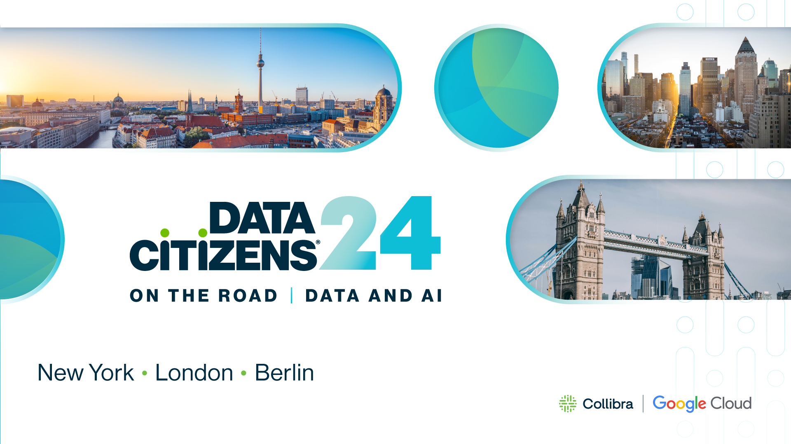
Rotterdam, Nov 19th See you there
Learn more • roadshow.collibra.com • October-November

Slide 22
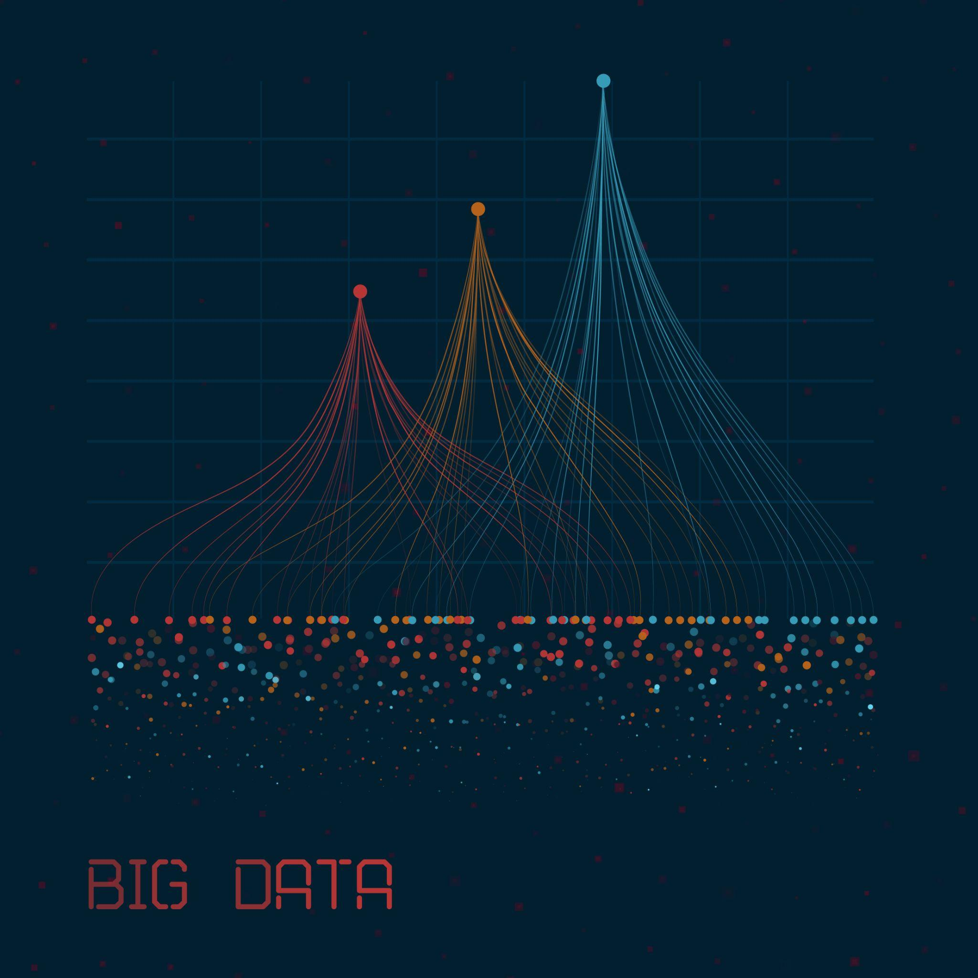
Increasing market pressure to treat data as an asset
Regulatory
Security
Organizational
Technology
GDPR, CCPA, … over 200+ data privacy regulations worldwide since 2016
Data Act
…
AI’s hype train continues
Internet of Things
Cloud
Blockchain
Data breaches: more frequent, and more data stolen
Bad actors see the value of data
Continuous improvement
2nd decade of CDO
Competitive differentiation
New data roles
Notes:
business drivers in de markt, die ervoor zorgen dat door reg, business MOETEN beheren

Slide 23
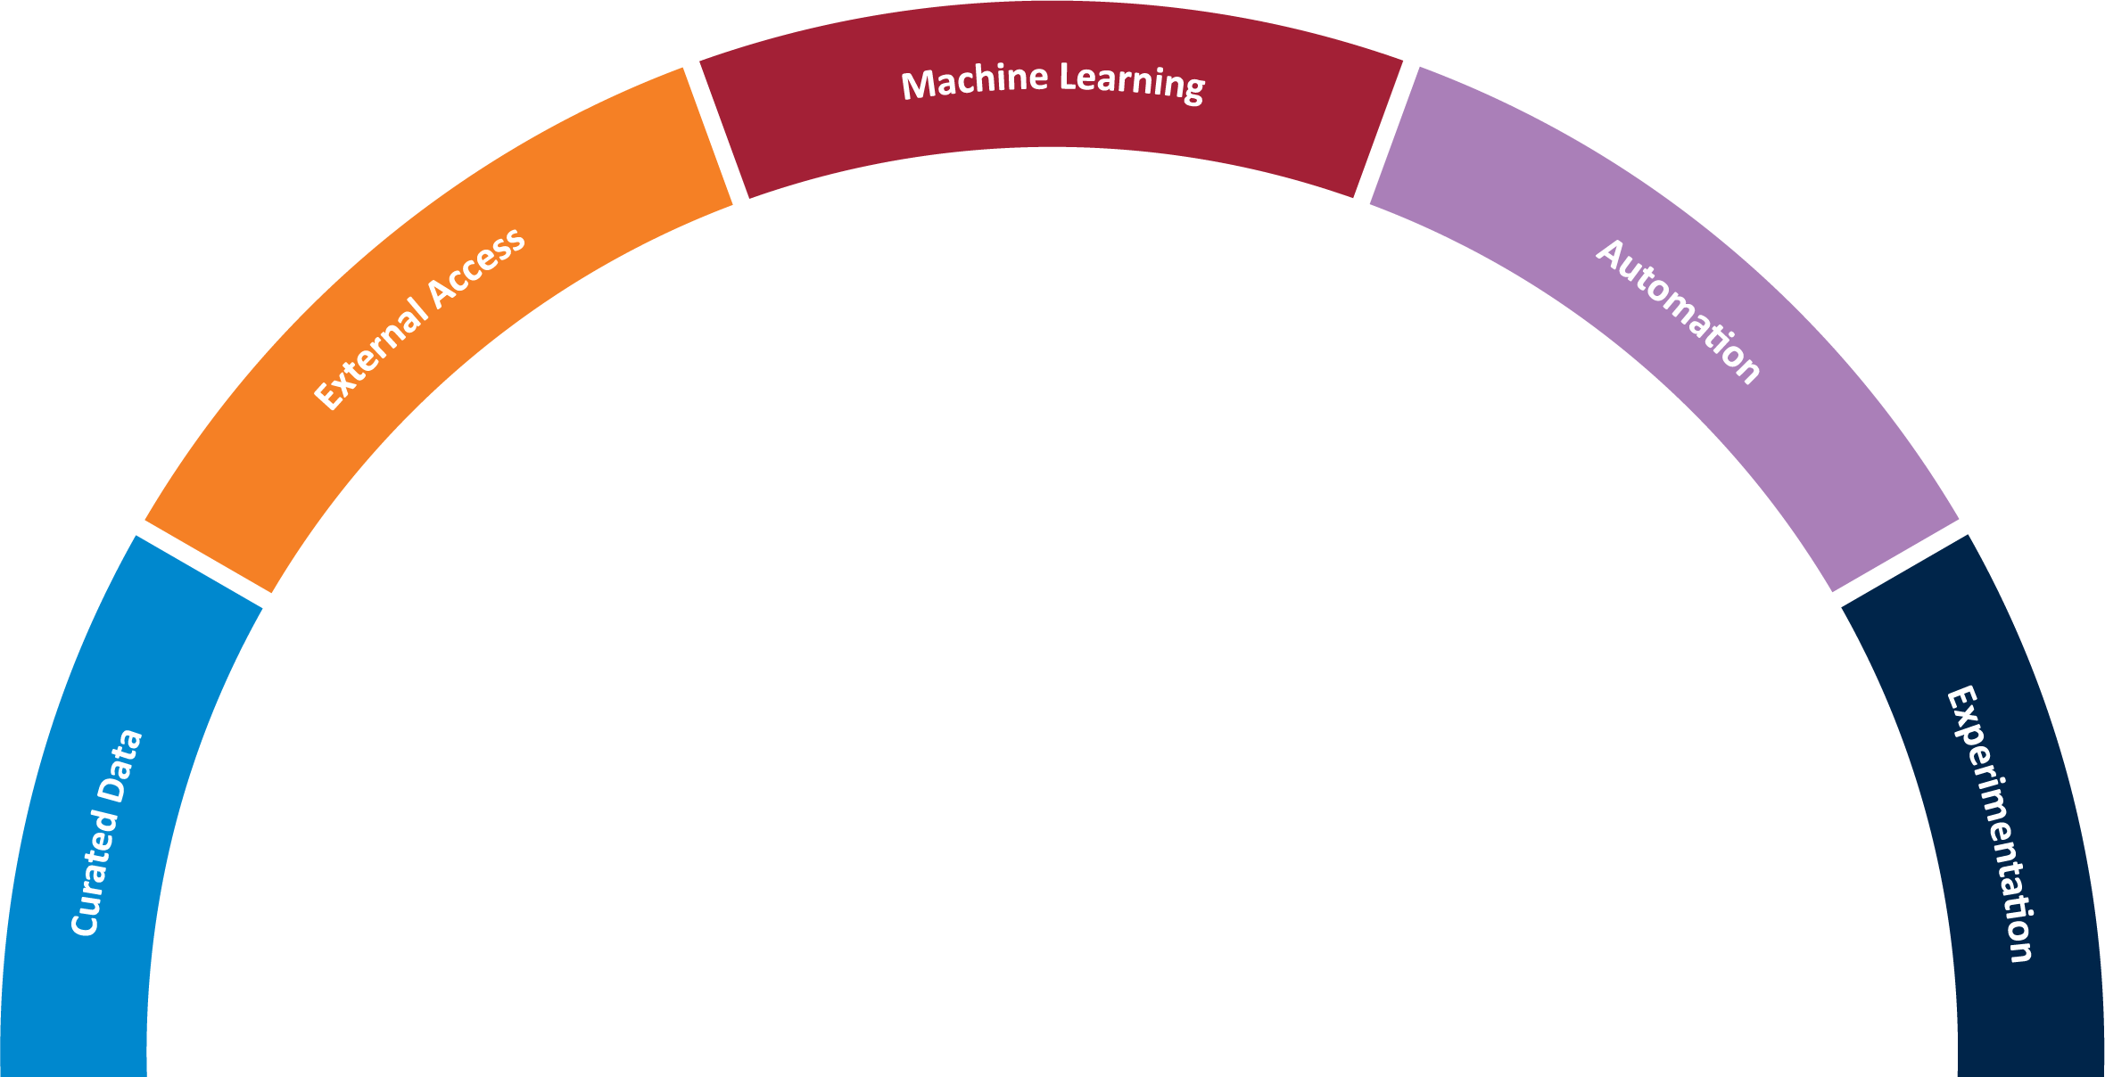
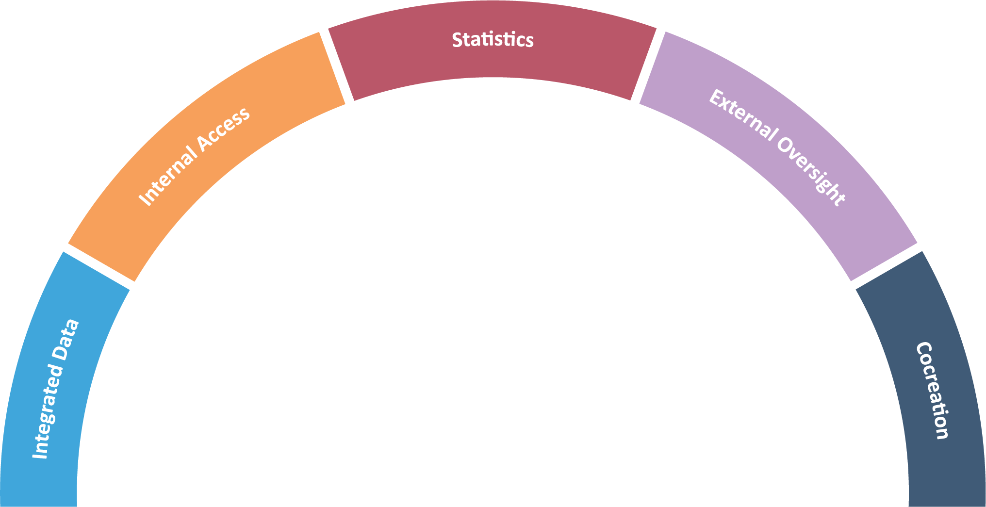
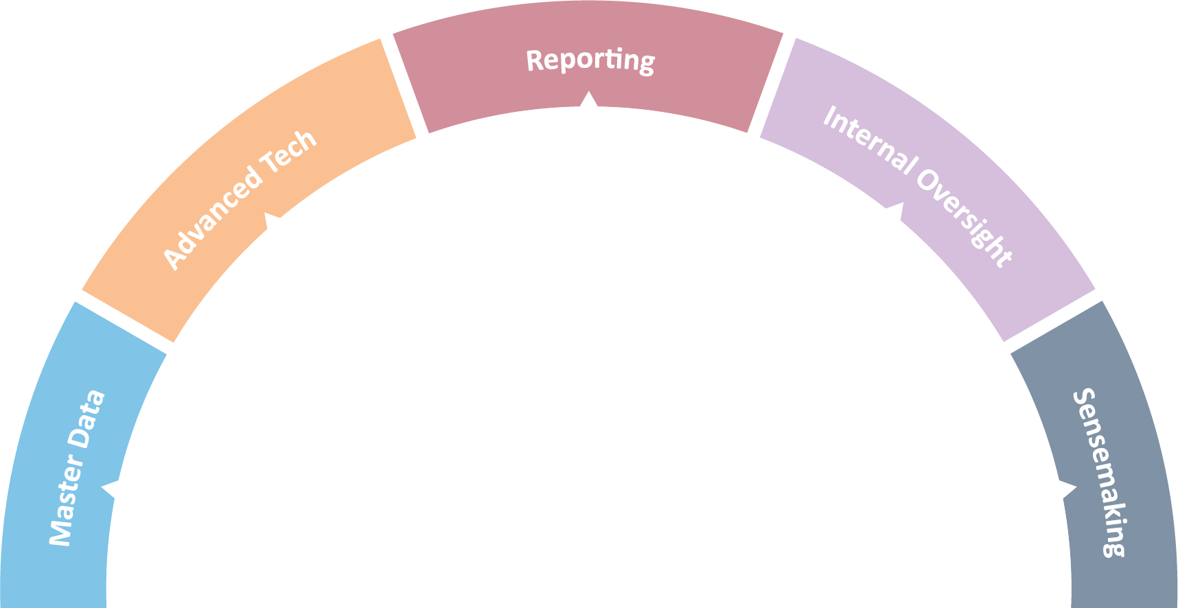
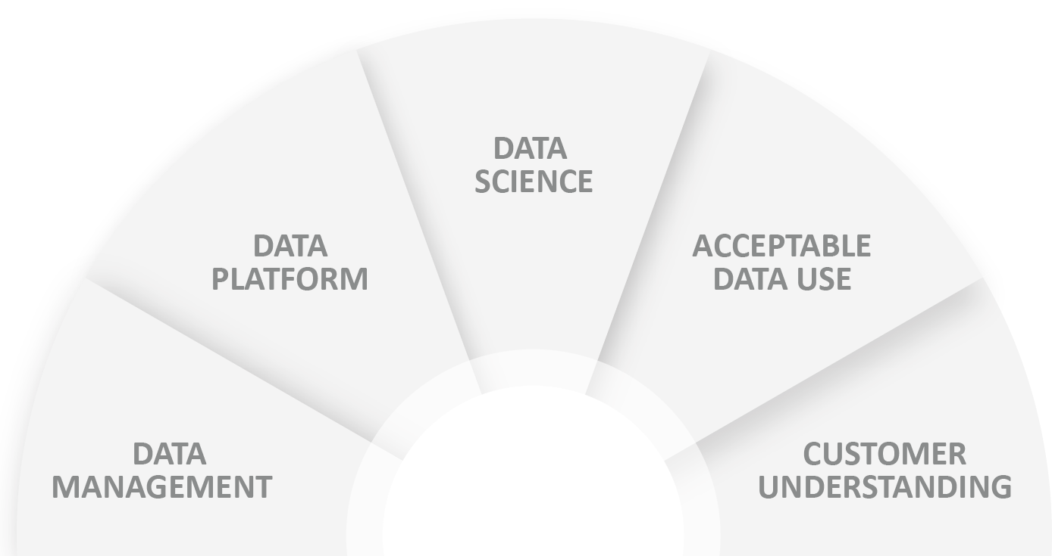
AI as a data product - Data Monetization
Read more at https://cisr.mit.edu/publication/2019_0401_DataMonetizationCapabilities_WixomOwens

Slide 24
Thank you
‹#›
Notes:
Thank you for your time today!
As always, it’s been a pleasure and I’m thrilled to be here with you at another Data Citizens event.
I’m going to turn this over now to Laura Sellers, our Chief Product Officer to tell you all about our innovation

